Slide 1
UNIT II
Data link layer: Design issues in data link layer: framing, flow control, error control, Error Detection and Correction: Parity, CRC checksum, Hamming code, Flow Control: Sliding Window Protocols, Applications: Data link layer protocols HDLC, PPP.

Slide 2
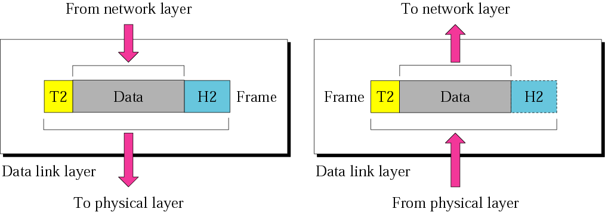
Data Link layer cont.
10110110101
01100010011
10110000001

Slide 3
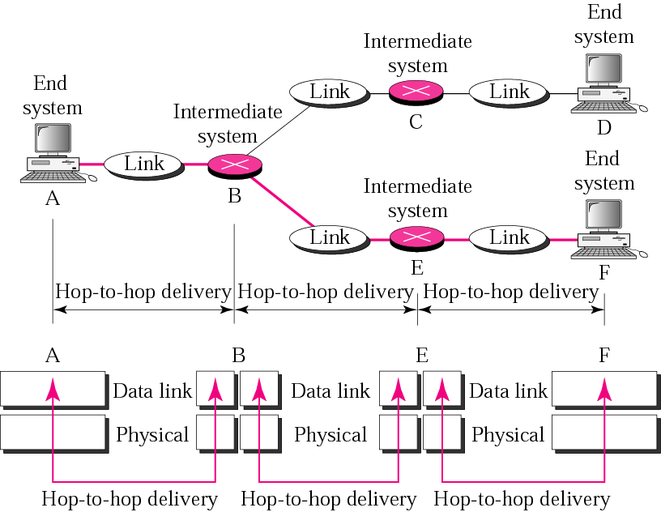
Hop-to-Hop delivery

Slide 4
UNIT II
Data Link Layer
The data link layer transforms the physical layer, a raw transmission facility, to a reliable link.
Responsible for node-to-node (hop-to-hop) communication.
Specific responsibilities of the data link layer include framing, addressing, flow control, error control, and media access control.

Slide 5
Framing: The data link layer divides the stream of bits received from the network layer into manageable data units called frames.
Addressing: Frames are to be distributed to different systems, the data link adds the header to the frame to define the receiver.

Slide 6
Flow Control: If the rate at which the data are absorbed by the receiver is less than the rate at which data are produced in the sender, the data link layer imposes a flow control mechanism to avoid overwhelming the receiver.
Error Control: The data link layer also adds reliability to the physical layer by adding mechanisms to detect and retransmit damaged, duplicate, or lost frames.
Access Control: When two or more devices are connected to the same link, data link layer protocols are necessary to determine which device has control over the link at any given time.

Slide 7
Data link layer:
Data-Link Layer has responsibility of transferring frames from one node to adjacent node over a link
DATA LINK LAYER DESIGN ISSUES:
Data link layer has a number of specific functions to carry out. These functions include
Provides a well-defined service interface to the network layer.
Determines how the bits of the physical layer are grouped into frames (framing).
Deals with transmission errors
Regulates the flow of frames.

Slide 8
Data link layer-Introduction
The data link layer takes the packets it gets from the network layer and encapsulates them into frames for transmission .
Each frame contains frame header ,a payload field for holding the packet ,and a frame trailer
Sending Machine
Receiving Machine
packet
packet
Header payload field Trailer
Header payload field Trailer
Relationship between packets and frames

Slide 9
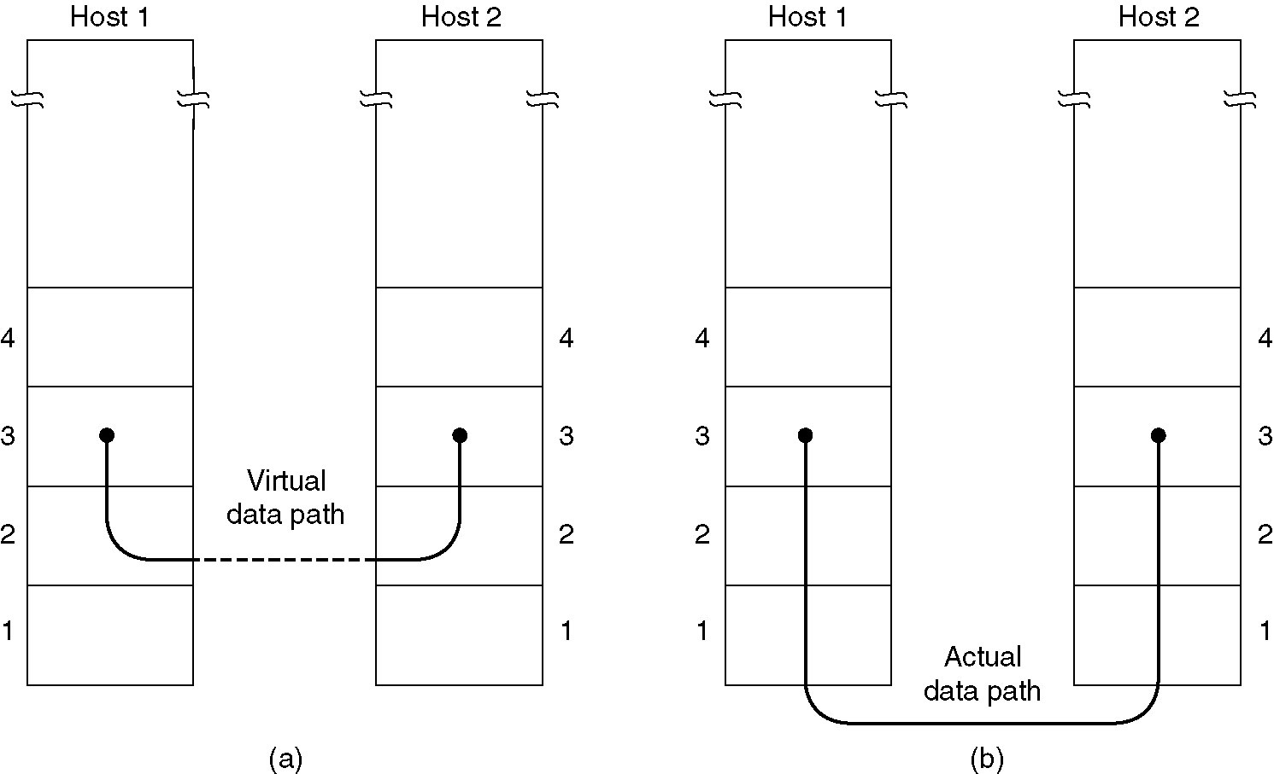
Data link layer-Introduction
Services Provided to the Network layer:
The function of the data link layer is to provide services to the network layer
The principal service is transferring data from the network layer on the source machine to the network layer on the destination machine.
(a) Virtual Communication (b)Actual communication

Slide 10
Types of services provided to the Network Layer
Unacknowledged Connectionless service
Acknowledged Connectionless service
Acknowledged Connection-Oriented service

Slide 11
Unacknowledged Connectionless service:
It consists of having the source machine send independent frames to the destination machine without having the destination acknowledge them.
No connection is established beforehand or released afterward
If a frame is lost due to noise on the line, no attempt is made to recover it in the data link layer.
Appropriate for voice, where delay is worse than bad data.
Most of the LANs use unacknowledged connection less service in the data link layer

Slide 12
Acknowledged Connectionless service
when this service is offered, there are still no logical connections used, but each frame sent is individually acknowledged.
In this way ,the sender knows whether a frame has arrived correctly.
If it has not arrived within a specified time interval it can be sent again.
This service is used over unreliable channels ,such as wireless systems.

Slide 13
Acknowledged Connection-Oriented service
The most sophisticated service the data link layer can provide to the network layer is connection-oriented service.
The source and destination machines establish a connection before any data are transferred
Each frame sent over the connection is numbered ,and the data link layer guarantees that each frame is received exactly once and that all frames are received in the right order
When connection oriented service is used ,transfers go through three distinct phases.
1) Connection established
2) Data transferred
3) connection Released

Slide 14
Framing:
In order to provide service to the network layer the data link layer must use the service provided to it by the physical layer.
Physical layer is used to accept the raw bit stream and attempt to deliver it to the destination
The bit stream is not guaranteed to be error free
The number of bits received may be less than ,equal to ,or more than the number of bits transmitted, and they may have different values
It is up to the data link layer to detect and if necessary ,correct errors.
The usual approach is for the data link layer to break the bit stream up into discrete frames and compute the checksum for each frame.

Slide 15
Framing:
When a frame arrives at the destination ,the checksum is recomputed.
If the newly computed checksum is different from the one contained in the frame, the data link layer knows that an error has occurred and take steps to deal with it.
e.g., discarding the bad frame and possibly also sending back an error report
Breaking the bit stream up into frames is more difficult than it at first appears, One way to achieve this framing is to insert time gaps between frames, much like the spaces between words in ordinary text.

Slide 16
Methods:
1) character count
2) Flag bytes with byte stuffing
3) starting and ending flags, with bit stuffing

Slide 17
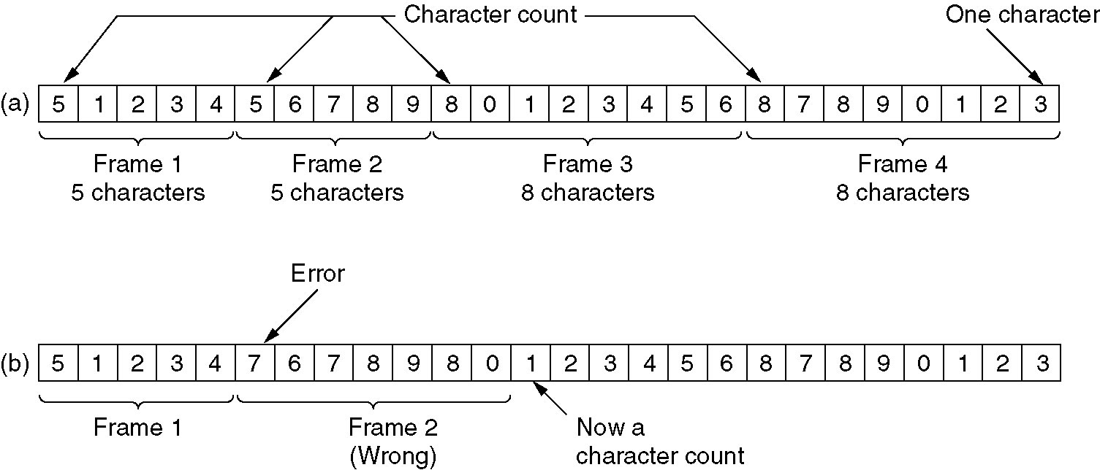
Character count:
A character stream a) with out errors b) with one error
The first framing method uses a field in the header to specify the number of characters in the frame.
When the data link layer in the destination sees the character count ,it knows how many characters follow and hence where the end of the frame is.

Slide 18
Character count:
The trouble with this algorithm is that the count can be garbled by a transmission error.
For example, if the character count of 5 in the second frame becomes a 7,the destination will get out of synchronization and will be unable to locate the start of the next frame.
Disadvantages:
The count can be garbled by the transmission error
Resynchronization is not possible Even if with checksum, the receiver knows that the frame is bad there is no way to tell where the next frame starts.
Asking for retransmission doesn’t help either because the start of the retransmitted frame is not known
No longer used

Slide 19
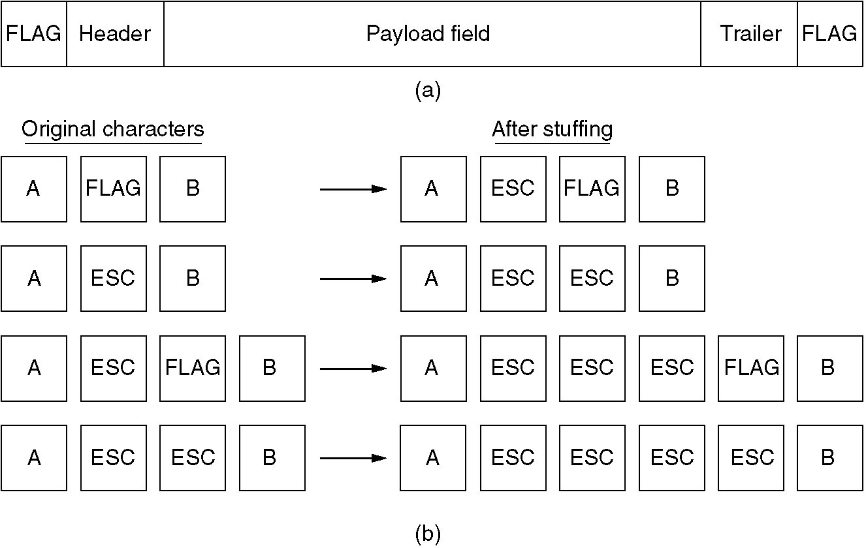
Character Stuffing/Byte Stuffing
(a) A frame delimited by flag bytes.
(b) Four examples of byte sequences before and after stuffing.

Slide 20
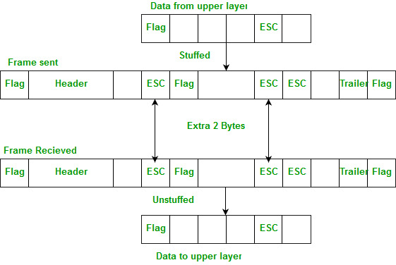
Character Stuffing/Byte Stuffing

Slide 21
The second transmission method gets around the problem of Resynchronization called character stuffing.
Most protocols used the same byte ,called flag byte, as both the starting and ending delimiter as FLAG.
Two consecutive flag bytes indicate the end of one frame and start of the next one.

Slide 22
Starting and ending flags, with bit stuffing
This new technique allows data frames to contain an arbitrary number of bits and allow character codes with an arbitrary number of bits per character.
Each frame begins and ends with a special bit pattern,0111110 called a flag byte.
whenever the senders data link layer encounters five consecutive ones in the data , it automatically stuffs a 0 bit into the outgoing bit stream.
whenever the receiver sees five consecutive incoming 1 bits, followed by a 0 bit ,it automatically destuffs (i.e deletes) the 0 bit.
If the flag pattern 01111110,this flag is transmitted as 011111010 but stored in the receiver memory as 01111110.

Slide 23
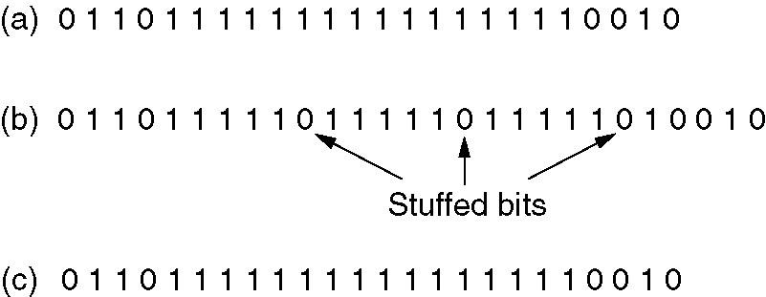
starting and ending flags, with bit stuffing
Bit stuffing
(a) The original data.
(b) The data as they appear on the line.
(c) The data as they are stored in receiver’s memory after destuffing.

Slide 24
Error Control:
Next problem: How to make sure all frames are eventually delivered to the network layer at the destination, and in the proper order.
The usual way to ensure reliable delivery is to provide the sender with some feedback about what is happening at the other end of the line.
The protocol calls for the receiver to send back special control frames bearing positive and negative acknowledgements about the incoming frames

Slide 25
Error Control:
If the sender receives a positive acknowledgement about a frame ,it knows the frame has arrived safely.
on the other hand, a negative acknowledgement means that something has gone wrong, and the frame must be transmitted again.
An additional complication comes from hardware troubles.
Managing the Timers and sequence numbers so as to ensure that each frame is ultimately passed to the network layer at the destination exactly once.

Slide 26
Error Control:
How to ensure that the frames are delivered
Positive ACK
Negative ACK
Maintaining Timers for Error Control: When a sender transmits a frame, it generally also starts a timer .
The timer is set to expire after an interval long enough for the frame to reach the destination, be processed there ,and have the acknowledgement to propagate back to the sender.
Normally, the frame will be correctly received and the acknowledgement will get back before the timer runs out ,in which case the timer will be cancelled.
However, if either the frame or the acknowledgement is lost ,the timer will go off ,alerting the sender to a potential problem .the obvious solution is to just transmit the frame again.
Sequence number is used to recognize the duplicate packet.

Slide 27
Flow control:
A sender that systematically wants to transmit frames faster than the receiver can accept them..
When the sender is running on a fast (or lightly loaded) computer and the receiver is running on a slow (or heavily loaded machine)
The sender keeps pumping the frames out at a higher rate until the receiver is completely swamped.
Even if the transmission is error free ,at a certain point the receiver will simply be unable to handle the frames as they arrive and will start to lose someone

Slide 28
To Prevent above situation two approaches are used
Feedback- based flow control
Rate-based flow control Feedback- based flow control ,the receiver sends back information to the sender giving it permission to send more data.
Rate-based flow control , the protocol has built- in mechanism that limits the rate at which senders may transmits data, without using feedback – based flow control

Slide 29
Error Detection and Correction methods

Slide 30
Error Detection and correction:
In some cases it is sufficient to detect an error and in some, it requires the errors to be corrected also.
For e.g.
On a reliable medium : Error Detection is sufficient where the error rate is low and asking for retransmission after Error Detection would work efficiently
In contrast, on an unreliable medium : Retransmission after Error Detection may result in another error and still another and so on. Hence Error Correction is desirable.

Slide 31
Data can be corrupted during transmission some applications require that error be detected and corrected.
ERROR: whenever bits flow from one point to another, they are subject to unpredictable changes because of interference this interference can change the shape of the signal.
Types of ERRORS:
1) single bit error
2) burst error

Slide 32
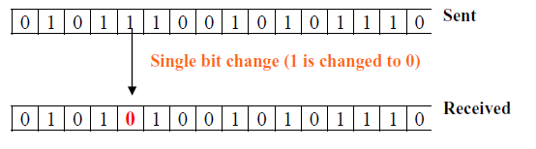
Single Bit Error
The term single-bit error means that only one bit of given data unit (such as a byte, character, or data unit) is changed from 1 to 0 or from 0 to 1.

Slide 33
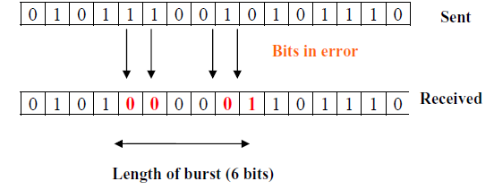
Burst Error
The term burst error means that two or more bits in the data unit have changed from 0 to 1 or vice-versa.
Note that burst error doesn’t necessary means that error occurs in consecutive bits.
The length of the burst error is measured from the first corrupted bit to the last corrupted bit. Some bits in between may not be corrupted.

Slide 34
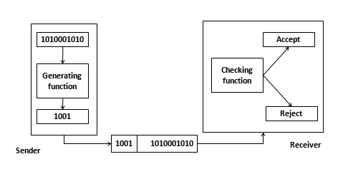
Error Detection :
They are few codes which are used to detect errors, not to prevent the occurrence of error or not to correct the occurred error.
Solution – a shorter group of data is appended to the end of the data unit . This technique is called Redundancy.

Slide 35
Error Detecting Codes
Basic approach used for error detection is the use of redundancy, where additional bits are added to facilitate detection and correction of errors. Popular techniques are:
Simple Parity check
Two-dimensional Parity check
Checksum
Cyclic redundancy check

Slide 36
Simple Parity Checking/One-dimension Parity Check/Vertical Redundancy Check(Vrc):
.It is most common and least expensive mechanism for error detection.
It is also called as Parity check.
Append a single bit at the end of data block such that the number of ones is even → Even Parity (odd parity is similar) 0110011 → 01100110 0110001 → 01100011
Performance: Detects all odd-number errors in a data block

Slide 37
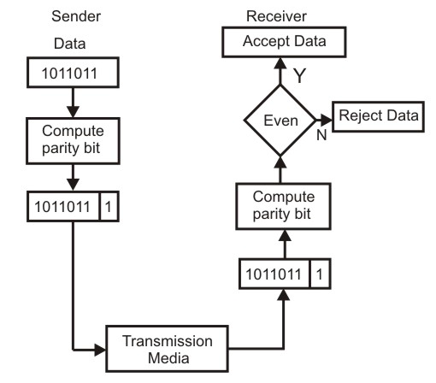

Slide 38
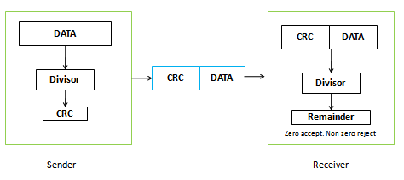
CRC(Cyclic Redundancy Check)
It is based on the binary division
Polynomial code are used for generating check bits in the form of cyclic redundancy check.

Slide 39
When the polynomial code method is employed ,the sender and receiver must agree upon a generator polynomial G(x) .
In advance both higher and lower order bits of generator must be 1.
To compute the check sum for some frame with m bits ,corresponding to the polynomial M(x), the frame must be longer than the generator polynomial.
The idea is to append a checksum to the end of the frame in such a way that the polynomial represented by the check summed frame is divisible by G(x).
When the receiver gets the check summed frame, it tries dividing it by G(x). If there is a remainder ,there has been a transmission error otherwise no error.
Notes:
39

Slide 40
Algorithm:
Let r be the degree of G(x)
Append r zero bits to the low-order end of the frame ,so it now contains m+r bits and corresponds to the polynomial x^{r}M(x).
Divide the bit string corresponding to G(x) in to the bit string corresponding to X^{r}M(x) using modulo 2 division.
subtract the remainder (which is always r or fewer bits ) from the bit string correspond to x^{r}M(x) using modulo 2 subtraction.
the result is the check summed frame to be transmitted .call its polynomial T(x).

Slide 41
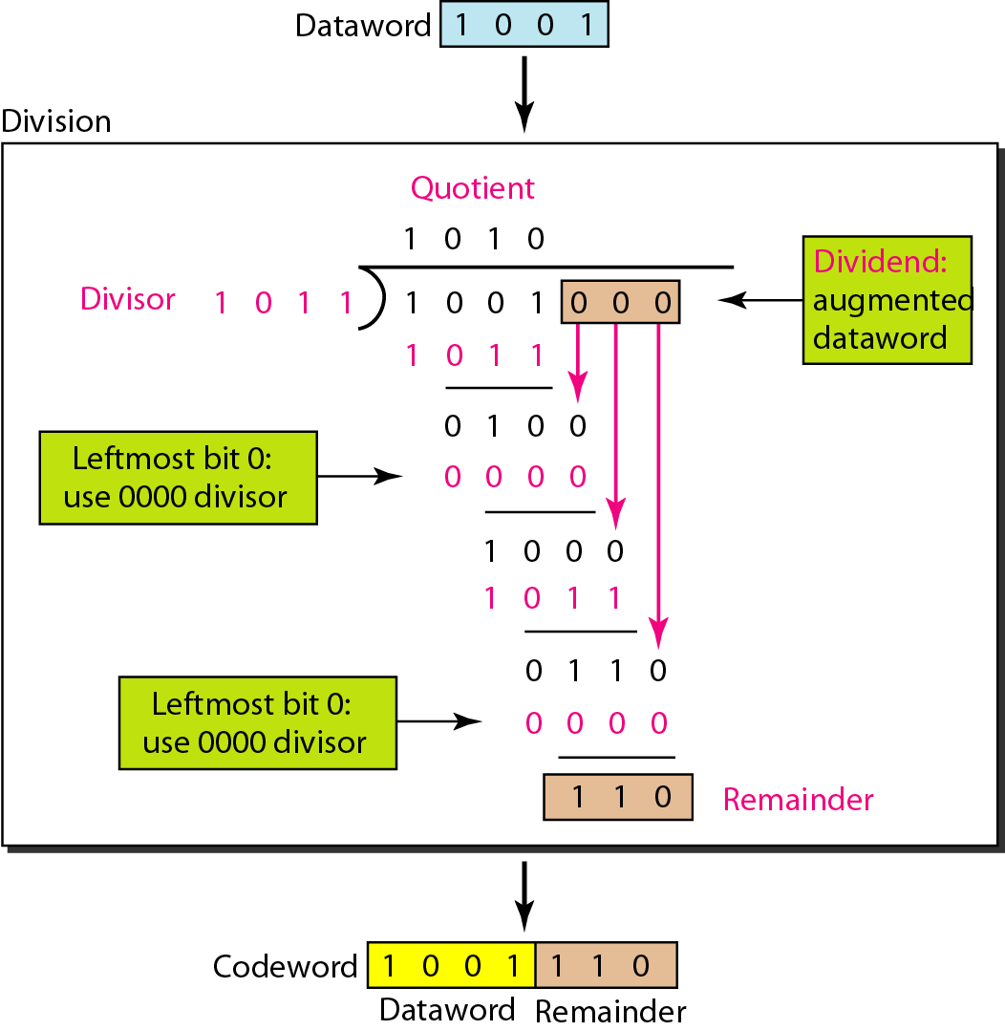
Calculation of the polynomial code checksum:
Frame: 1001 Generator : 1011

Slide 42
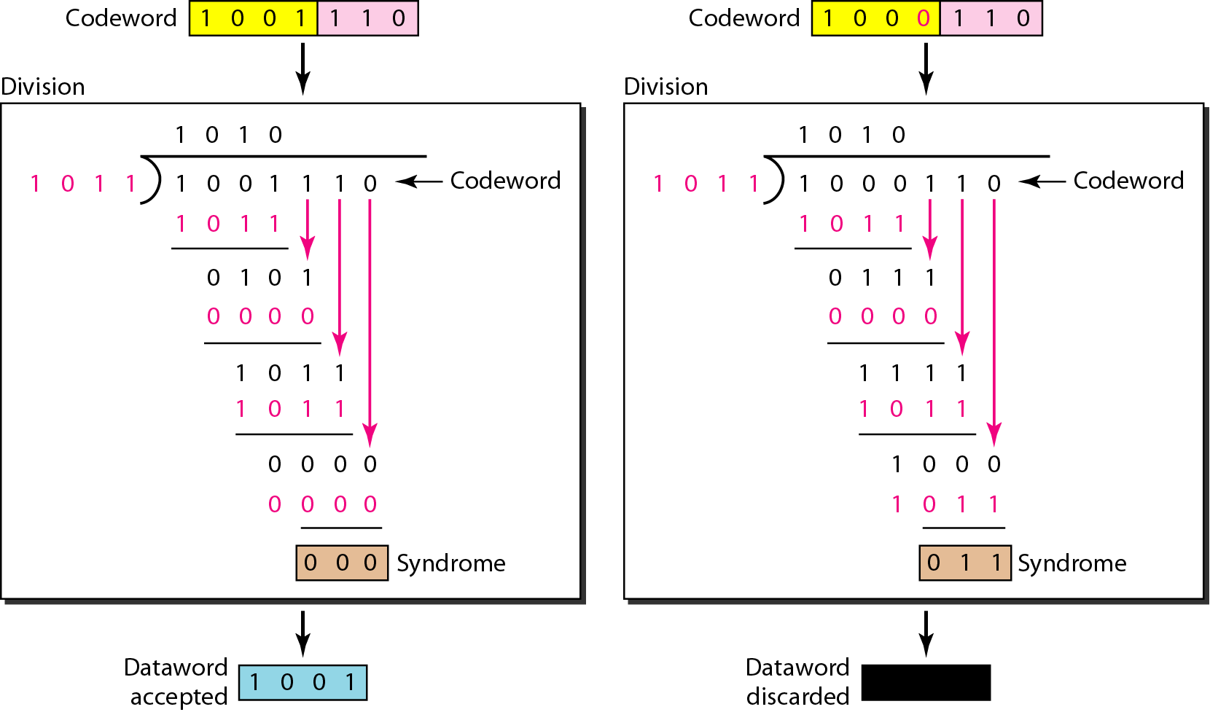
Division in the CRC decoder for two cases:

Slide 43
Performance of CRC:
CRC is a very effective error detection technique. If the divisor is chosen according to the previously mentioned rules, its performance can be summarized as follows:
CRC can detect all single-bit errors
CRC can detect all double-bit errors (three 1’s)
CRC can detect any odd number of errors (X+1)
CRC can detect all burst errors of less than the degree of the polynomial.
CRC detects most of the larger burst errors with a high probability.
• For example CRC-12 detects 99.97% of errors with a length 12 or more

Slide 44
Error Correcting codes

Slide 45
The techniques that we have discussed so far can detect errors, but do not correct them.
Error Correction can be handled in two ways.
One is when an error is discovered; the receiver can have the sender retransmit the entire data unit. This is known as backward error correction.
In the other, receiver can use an error-correcting code, which automatically corrects certain errors. This is known as forward error correction.

Slide 46
Error correcting codes:
Forward Error Correction: FEC is the only error correction scheme that actually detects and corrects transmission errors at the receive end with out calling for retransmission.
Ex: Hamming code
No of bits in hamming code is dependent on the no. of bits in the data character by using the relation.
2^{n}>=m+n+1
Where n=no. of hamming bits
m= no. of bits in the data character

Slide 47
Error correcting codes:
No. of bits in hamming code
2^{n}>=m+n+1
Take n=4
2⁴=16>=12+4+1
16>=17
Take n=5
2⁵=32>=12+5+1=18
32>=18 ---- 5 bits are required for hamming code.
12 bits of data +5 bits of code=17 bits of data stream.

Slide 48
Error correcting codes:

Slide 49
Hamming Code

Slide 50
Calculation of redundancy bits for 7 bit data
R1- r1 d3 d5 d7 d9 d11
R2-r2 d3 d6 d7 d10 d11
R4-r4 d5 d6 d7
R8-r8 d9 d10 d11
Note: these bits are fixed.

Slide 51
Hamming Code

Slide 52
Hamming Code

Slide 53
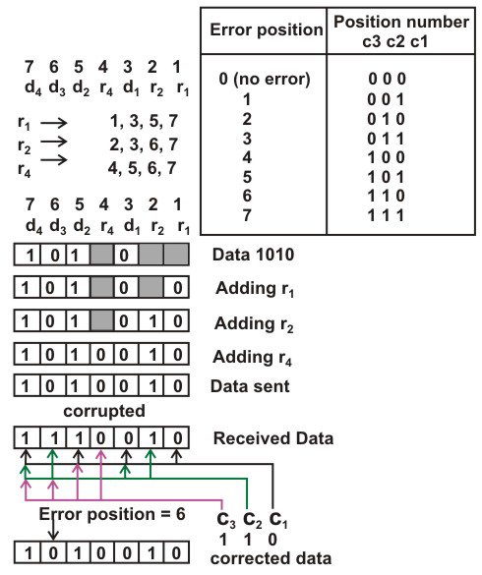

Slide 54
Figure 9-19
Hamming Code
WCB/McGraw-Hill
© The McGraw-Hill Companies, Inc., 1998

Slide 55
Figure 9-19-continued
Hamming Code
WCB/McGraw-Hill
© The McGraw-Hill Companies, Inc., 1998

Slide 56
Figure 9-20
Example of Hamming Code
WCB/McGraw-Hill
© The McGraw-Hill Companies, Inc., 1998

Slide 57
Figure 9-21
Single-bit error
WCB/McGraw-Hill
© The McGraw-Hill Companies, Inc., 1998

Slide 58
Figure 9-22
Error
Detection
WCB/McGraw-Hill
© The McGraw-Hill Companies, Inc., 1998

Slide 59
Above figure shows how hamming code is used for correction for 4-bit numbers (d4d3d2d1) with the help of three redundant bits (r3r2r1).
For the example data 1010, first r1 (0) is calculated considering the parity of the bit positions, 1, 3, 5 and 7. Then the parity bits r2 is calculated considering bit positions 2, 3, 6 and 7. Finally, the parity bits r4 is calculated considering bit positions 4, 5, 6 and 7 as shown.
If any corruption occurs in any of the transmitted code 1010010, the bit position in error can be found out by calculating r3r2r1 at the receiving end.
For example, if the received code word is 1110010, the recalculated value of r3r2r1 is 110, which indicates that bit position in error is 6, the decimal value of 110.

Slide 60
Data Link Layer Protocols
Flow Control in Data Link Layer

Slide 61
FLOW CONTROL
Flow control coordinates the amount of data that can be sent before receiving an acknowledgment and is one of the most important duties of the data link layer.
In most protocols, flow control is a set of procedures that tells the sender how much data it can transmit before it must wait for an acknowledgment from the receiver.
The flow of data must not be allowed to overwhelm the receiver.
Any receiving device has a limited speed at which it can process incoming data and a limited amount of memory in which to store incoming data.
The receiving device must be able to inform the sending device before those limits are reached and to request that the transmitting device send fewer frames or stop temporarily.

Slide 62
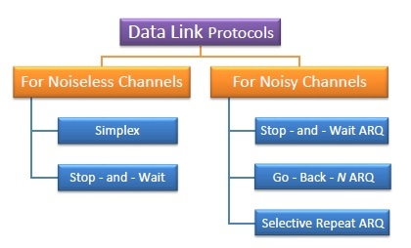

Slide 63
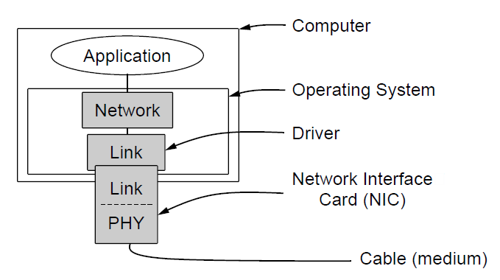
Elementary Data Link Protocols
Implementation of the physical, data link, and network layers.

Slide 64
Sliding window protocols:
In the Previous protocols ,Data frames were transmitted in one direction only.
In most practical situations ,there is a need for transmitting data in both directions.
One way of achieving full-duplex data transmission is to have two separate communication channels and each one for simplex data traffic (in different directions)
we have two separate physical circuits ,each with a “forward” channel (for data) and a “reverse” channel( for acknowledgements).
Data
source
Acknowledgements
Destination

Slide 65
Sliding window protocols:
Disadvantage: The bandwidth of the reverse channel is almost entirely wasted.
A better idea is to use the same circuits for data in both directions
In this model the data frames from A and B are intermixed with the acknowledgement frames from A to B.
Kind: kind field in the header of an incoming frame, the receiver can tell whether the frame is data or acknowledgements.

Slide 66
Sliding window protocols:
Piggybacking:
Frame sent(Frame1)
source
Destination
Ack(frame1)+Frame2
When a data frame arrives, instead of immediately sending a separate control frame, the receiver restrains itself and waits until the network layer passes it the next packet.
The acknowledgement is attached to the outgoing data frame
Disadv: This technique is temporarily delaying outgoing acknowledgements.
If the data link layer waits longer than the senders timeout period, the frame will be retransmitted.

Slide 67
Sender Sliding Window

Slide 68
Sliding Window Protocol (Duplex)
At any instant of time, the sender maintains a set of sequence numbers corresponding to frames it is permitted to send – this includes
frames not yet sent
Frames sent but not yet acknowledged .. May have to be sent again
This corresponds to the sender’s window. When a packet comes from the Network Layer ..it is appended in the window and when an ack arrives for a frame..it is deleted from the buffer(and from the window)

Slide 69
Figure 10-13
Receiver Sliding Window
WCB/McGraw-Hill
© The McGraw-Hill Companies, Inc., 1998

Slide 70
Sliding Window Protocol(Duplex)
Similarly, the receiver also maintains a set of sequence numbers corresponding to frames it is permitted to accept.
When a frame arrives, its seq number is checked..if it falls in the window it is accepted else discarded .. Once an ack is sent for a frame it is deleted from the window so that duplicate frames are not accepted.
Sliding window gives the Data Link Layer the flexibility to accept the frames in any order but they must be handed over to the Network Layer in order.

Slide 71
Sliding Window Example

Slide 72
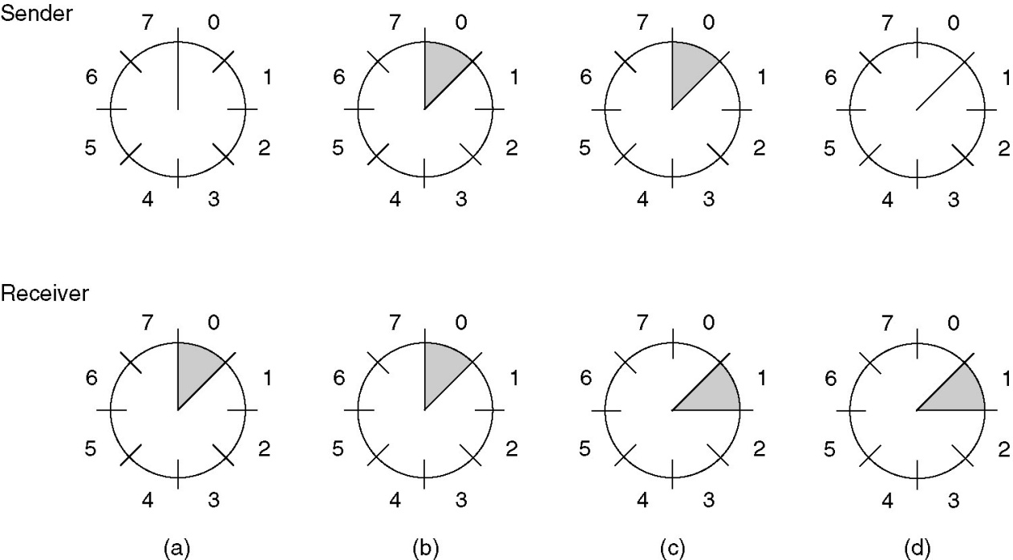
Sliding Window Protocols
A sliding window of size 1, with a 3-bit sequence number.
(a) Initially.
(b) After the first frame has been sent.
(c) After the first frame has been received.
(d) After the first acknowledgement has been received.

Slide 73
Sliding Window Protocols
A One-Bit Sliding Window Protocol
A Protocol Using Go Back N
A Protocol Using Selective Repeat

Slide 74
Sliding window protocols:
1-bit sliding window protocol:
Window size 1.
Stop-and-wait.(ARQ)
Must get ack before can send next frame.
Both machines are sending and receiving.
Problem: Only one frame will be in transit.

Slide 75
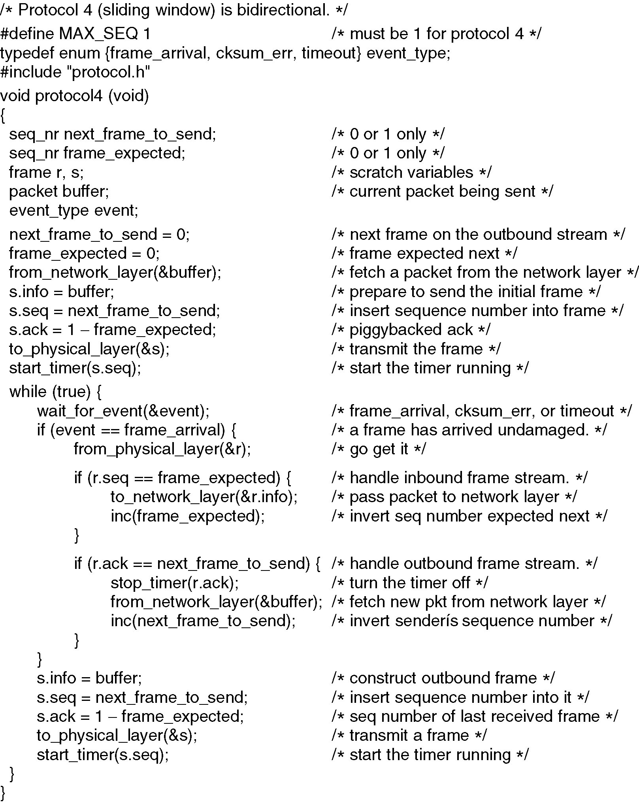
A One-Bit Sliding Window Protocol
Continued →

Slide 76
A One-Bit Sliding Window Protocol (ctd.)

Slide 77
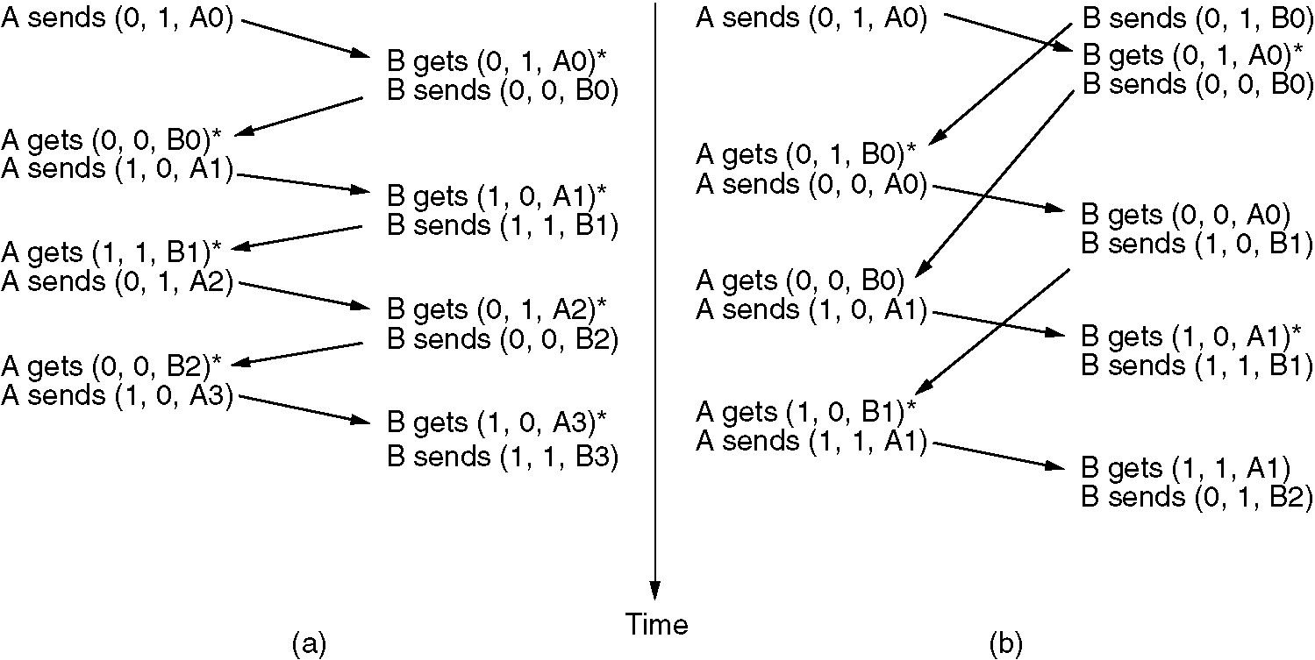
A One-Bit Sliding Window Protocol (2)
Two scenarios (a) Normal case. (b) Abnormal case. The notation is (seq, ack, packet number). An asterisk indicates where a network layer accepts a packet.

Slide 78
Bad scene : duplicates without transmission error
When B sends before receiving a frame from A.

Slide 79
Long propagation delays
Consider a 50 kbps satellite channel with a round trip delay of 500 msec (10^-3 sec).
To send a frame of size 1000 bits ..it takes = 1000/50kbps = 20msec.
At t=0, the sender sends the first bit and at
t = 20 msec it sends the last bit.
At t= 270 msec, the frame completely reaches the receiver.
Not before t= 520 msec , the ack arrives back at the receiver ( it will be later than this). This means that the sender was blocked for 500 msec out of 520 msec.

Slide 80
Contd..
That means
Long propagation delays
High bandwidth
And, short frame length
Is bad in terms of channel efficiency.
A large window size is needed at the sender’s end whenever the bandwidth and round trip delay is large.

Slide 81
Pipelining
Imagine in the above example, if the sender could send more frames without waiting for the ack for the first one, the channel could have been utilized more efficiently. This technique is called pipelining.

Slide 82
Pipelining contd…
Let
Channel capacity is b bits/sec
Frame size l bits,
Round trip propagation time is R
The time required to transmit a single frame is l/b.
So, in stop n wait, the line is busy for l/b time and idle for R time, thus the line utilization is
l/(l + bR).
If l < bR, the efficiency will be less than 50%.

Slide 83
Pipelining over noisy channels
What if one or more frames is errored.
Two options :
Throw away all the subsequent frames and go back and start resending from the damaged frame. - Go back N Protocol
Buffer the subsequent frames and wait for the damaged frame to be resent, once that comes handover the frames in proper order to the Network Layer-Selective Repeat Protocol

Slide 84
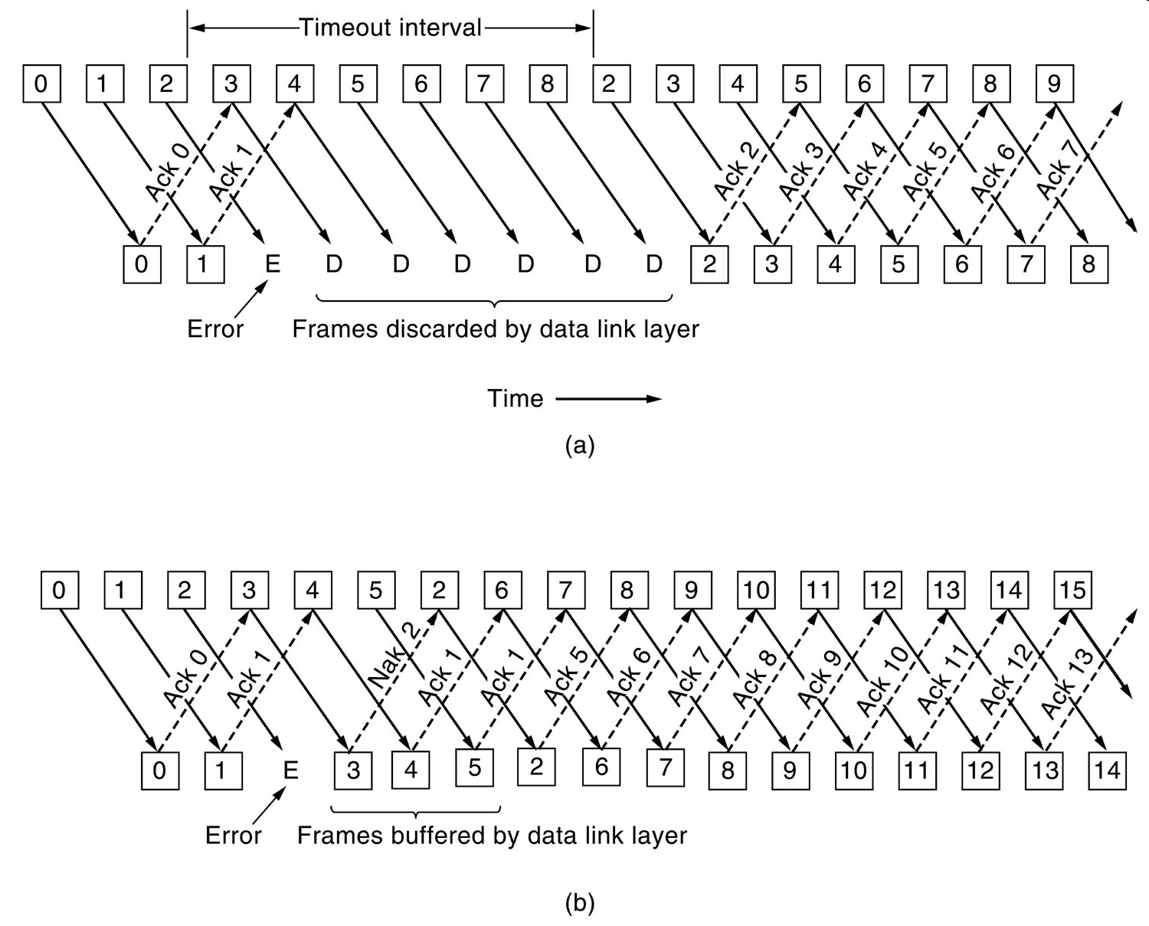
A protocol using Go Back N and selective repeat:

Slide 85
A protocol using Go Back N:
Go Back n, is for the receiver simply to discard all subsequent frames, sending no acknowledgements for the discarded frames. This strategy corresponds to a receive window of size 1.
The data link layer refuses to accept any frame except the next one it must give to the network layer.
Points: fig ( a)
1) frame 0 and 1 correctly received and Acknowledged
2) Frame 2 is damaged or lost ,The sender continuous to send frames until the timer for frame 2 expires.
3) Then it backs up to frame 2 and starts all over with it ,sending 2,3,4 etc. all over again.

Slide 86
Selective Repeat:
When selective repeat is used ,a bad frame that is received is discarded. But good frames after it are buffered.
when the senders timeout ,only the oldest unacknowledged frame is retransmitted.
If that frames arrives correctly ,the receiver can deliver it to the network layer in sequence all the frames it has buffered.
fig (b) :
1) Frames 0 and 1 correctly received and acknowledged.
2) Frame 2 is lost, when frame 3 arrives at the receiver ,the data link layer notices that it has a missed frame. so it sends back a NAK for 2 but buffers 3
3) when frame 4 and 5 arrive ,they are buffered by the data link layer instead of being passed to the network layer
4)The NAK 2 gets back to the sender which immediately resends frame 2.

Slide 87
Comparison
Trade off between the bandwidth utilization and the buffer space in the receiver.

Slide 88
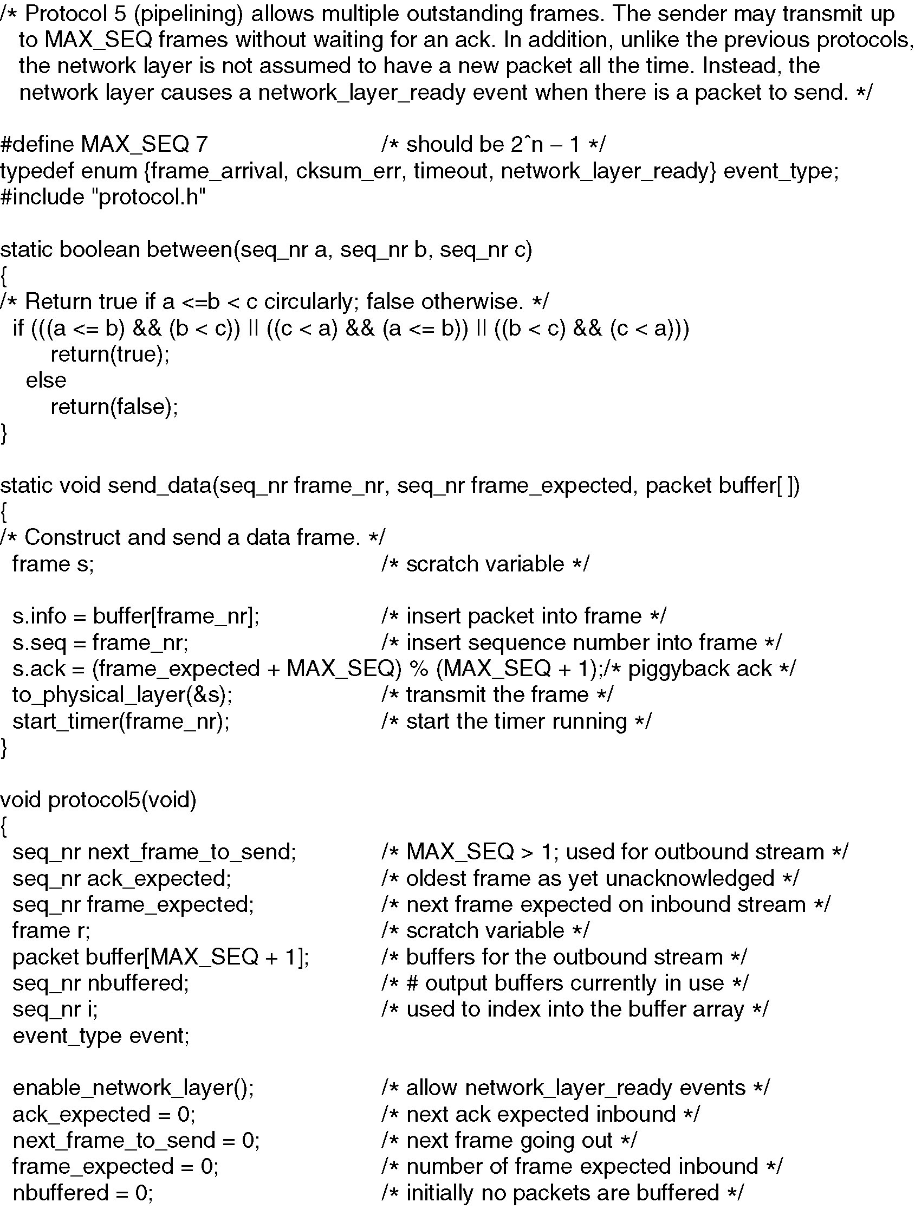
Sliding Window Protocol Using Go Back N
Continued →

Slide 89
Sliding Window Protocol Using Go Back N
Continued →

Slide 90
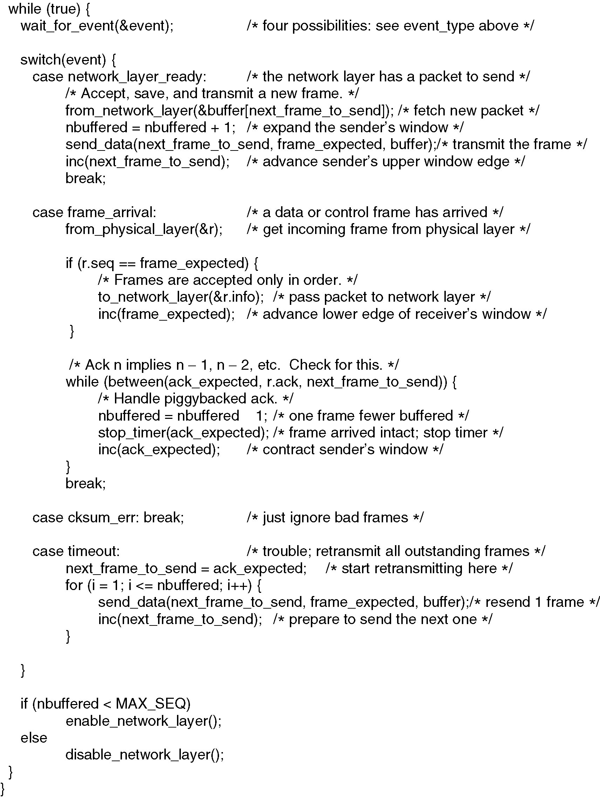
Sliding Window Protocol Using Go Back N
Continued →

Slide 91
Sliding Window Protocol Using Go Back N

Slide 92
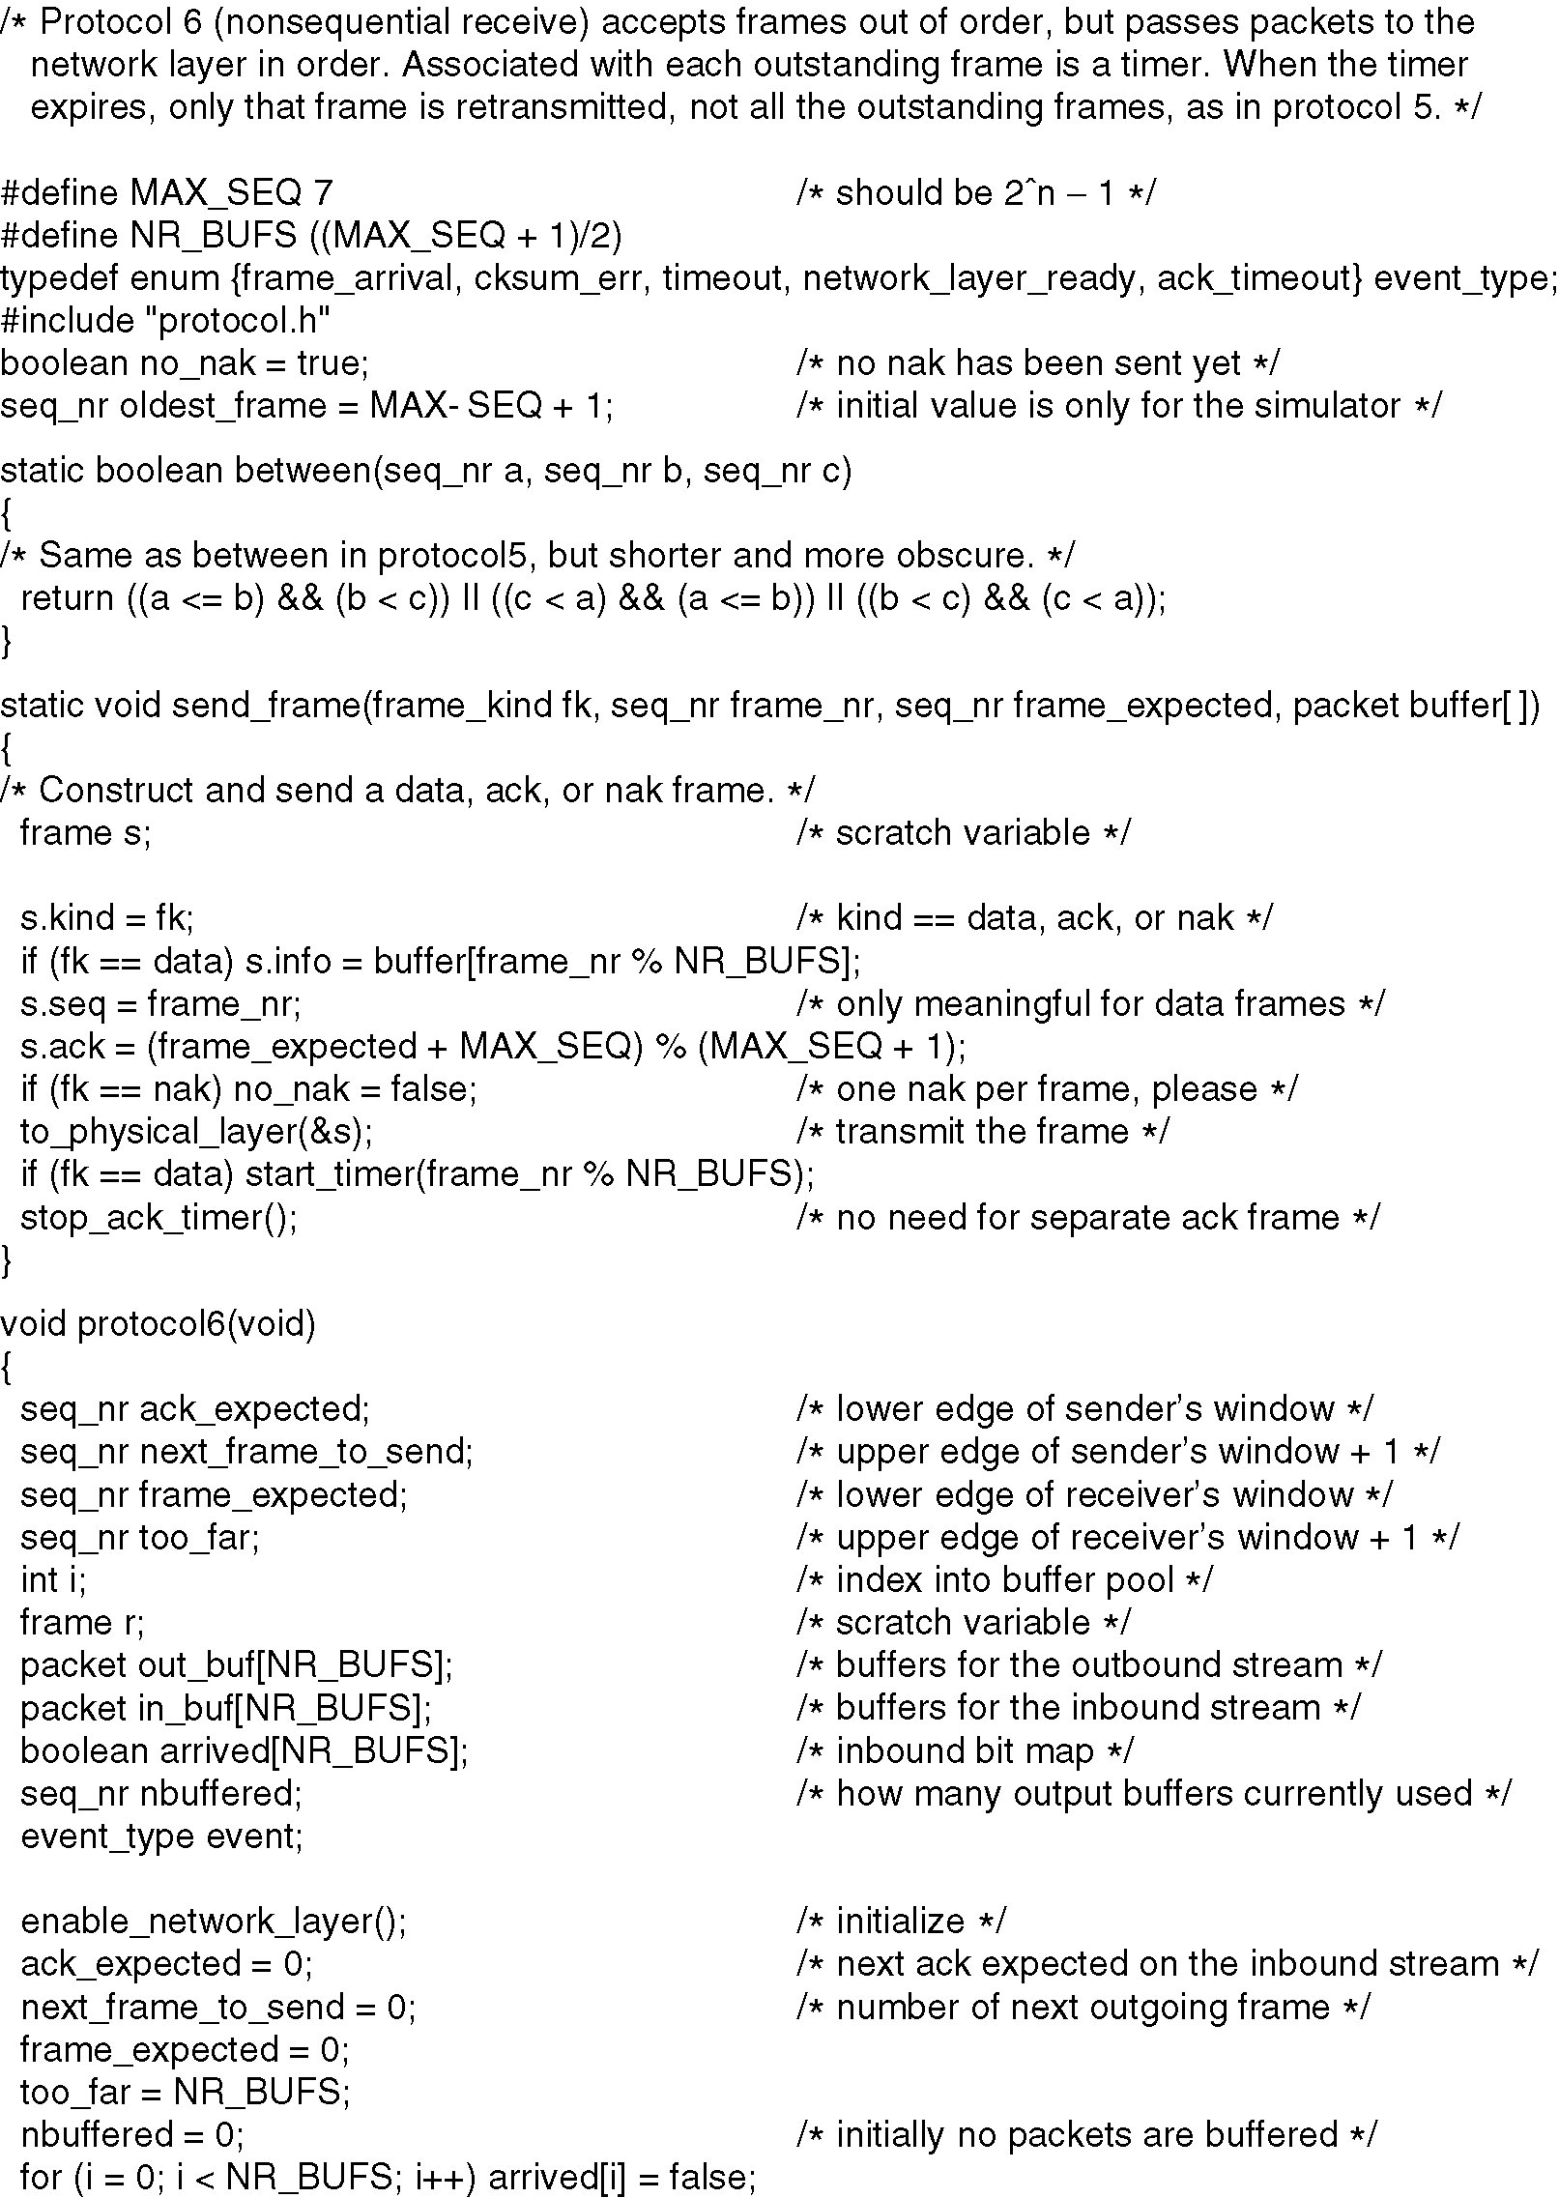
A Sliding Window Protocol Using Selective Repeat
Continued →

Slide 93
A Sliding Window Protocol Using Selective Repeat (2)
Continued →

Slide 94
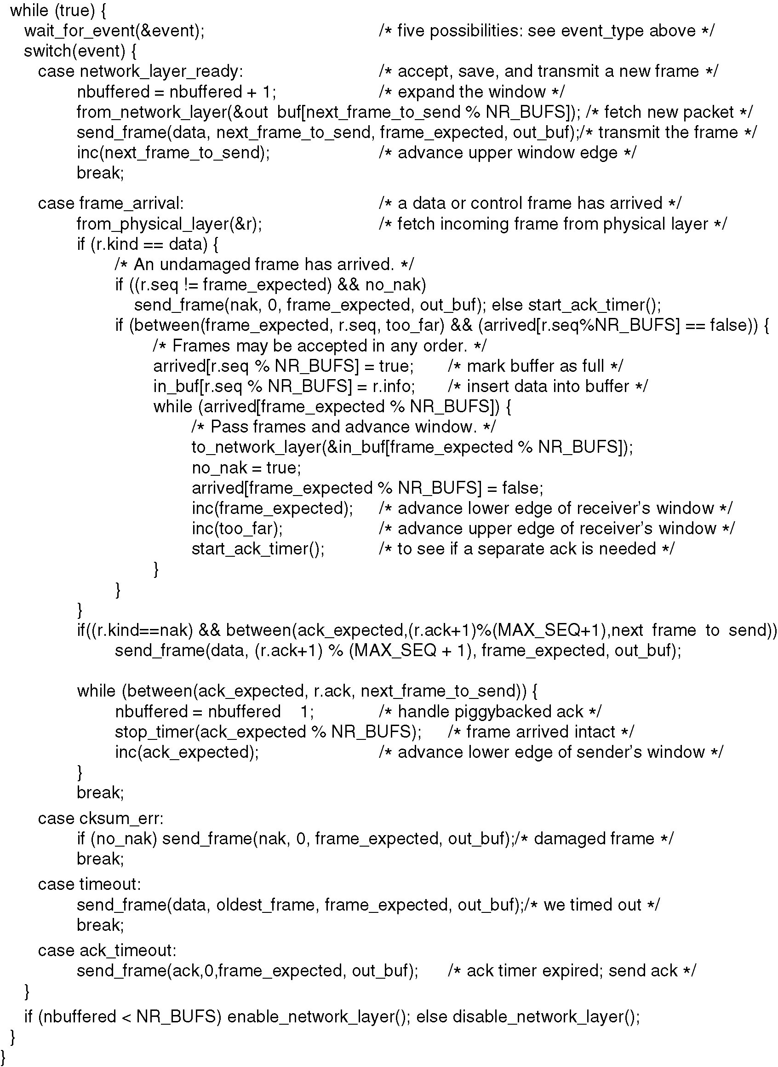
A Sliding Window Protocol Using Selective Repeat (3)
Continued →

Slide 95
A Sliding Window Protocol Using Selective Repeat (4)

Slide 96
 |  | Stop and Wait protocol | Sliding Window protocol
1 | Mechanism | In Stop and Wait protocol, sender sends single frame and waits for acknowledgment from the receiver. | In Sliding window protocol, sender sends multiple frames at a time and retransmits the damaged, lost frames.
2 | Efficiency | Stop and Wait protocol is less efficient. | Sliding Window protocol is more efficient than Stop and Wait protocol.
3 | Window Size | Sender's window size in Stop and Wait protocol is 1. | Sender's window size in Sliding Window protocol varies from 1 to n.
4 | Sorting | Sorting of frames is not needed. | Sorting of frames is needed. Because Network Layer accepts frames in order only
5 | Duplex | Stop and Wait protocol is half duplex in nature. | Sliding Window protocol is full duplex in nature.
6 | Propagation delay | Long | Short
7 | Link utilisation | Poor | Better

Slide 97
Comparison
 | Go-Back-N | Selective Repeat
Basic | Retransmits all the frames that sent after the frame which is damaged or lost. | Retransmits only those frames that are lost or damaged
Bandwidth Utilization | If error rate is high, it wastes a lot of bandwidth. | Comparatively less bandwidth is wasted in retransmitting.
Complexity | Less complicated. | More complex as it require to apply extra logic and sorting and storage, at sender and receiver.
Sorting | Sorting is neither required at sender side nor at receiver side. | Receiver must be able to sort as it has to maintain the sequence of the frames.

Slide 98
HDLC-High Level Data Link Control

Slide 99
HDLC is a bit oriented protocol that supports both half-duplex and full-duplex communication over point to point & multipoint link.
Since it is a data link protocol, data is organized into frames. A frame is transmitted via the network to the destination that verifies its successful arrival
For any HDLC communications session, one station is designated as primary and the other is secondary.
Transfer Modes- HDLC supports two types of transfer modes, normal response mode and asynchronous balanced mode.

Slide 100
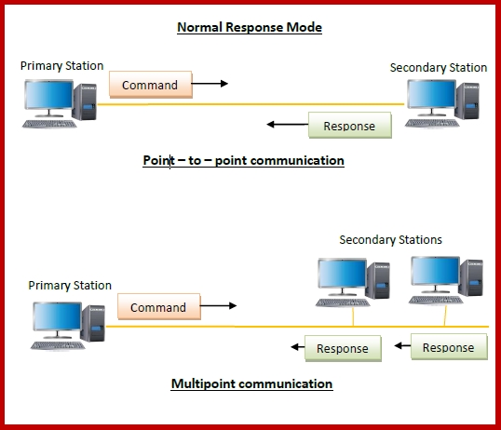
Normal Response Mode (NRM) − Here, two types of stations are there, a primary station that send commands and secondary station that can respond to received commands. It is used for both point - to - point and multipoint communications.

Slide 101
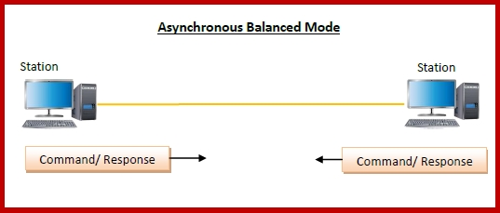
Asynchronous Balanced Mode (ABM) − Here, the configuration is balanced, i.e. each station can both send commands and respond to commands. It is used for only point - to - point communications.

Slide 102
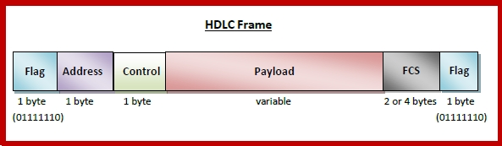
Flag − It is an 8-bit sequence that marks the beginning and the end of the frame. The bit pattern of the flag is 01111110.
Address − It contains the address of the receiver. If the frame is sent by the primary station, it contains the address(es) of the secondary station(s). If it is sent by the secondary station, it contains the address of the primary station. The address field may be from 1 byte to several bytes.
Control − It is 1 byte containing flow and error control information.
Payload − This carries the data from the network layer. Its length may vary from one network to another.
FCS − It is a 2 byte or 4 bytes frame check sequence for error detection. The standard code used is CRC (cyclic redundancy code)

Slide 103
High level data link control:
Frame Formats- 3 types:
I-Frame ( Information Frame)- is used to carry user data and control information related with user data
S-Frame (Supervisory Frame)- is used to transport control information.
U-Frame( Unnumbered Frame)- reserved for system management

Slide 104
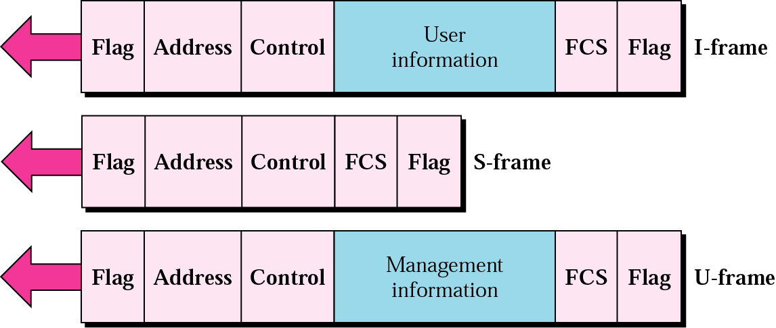
HDLC frame types

Slide 105
Figure 11-17
HDLC Flag Field
WCB/McGraw-Hill
© The McGraw-Hill Companies, Inc., 1998

Slide 106
Figure 11-19
HDLC Address Field
WCB/McGraw-Hill
© The McGraw-Hill Companies, Inc., 1998

Slide 107
Figure 11-20
HDLC Control Field
WCB/McGraw-Hill
© The McGraw-Hill Companies, Inc., 1998

Slide 108
Figure 11-21
Poll/Final
The P/F field is a single bit with a dual purpose. It has meaning only when it is set (bit = 1) and can mean poll or final. It means poll when the frame is sent by a primary station to a secondary (when the address field contains the address of the receiver). It means final when the frame is sent by a secondary to a primary (when the address field contains the address of the sender).
WCB/McGraw-Hill
© The McGraw-Hill Companies, Inc., 1998

Slide 109
Figure 11-22
HDLC Information Field
WCB/McGraw-Hill
© The McGraw-Hill Companies, Inc., 1998

Slide 110
Figure 11-23
HDLC FCS Field
WCB/McGraw-Hill
© The McGraw-Hill Companies, Inc., 1998

Slide 111
Figure 11-24
WCB/McGraw-Hill
© The McGraw-Hill Companies, Inc., 1998

Slide 112
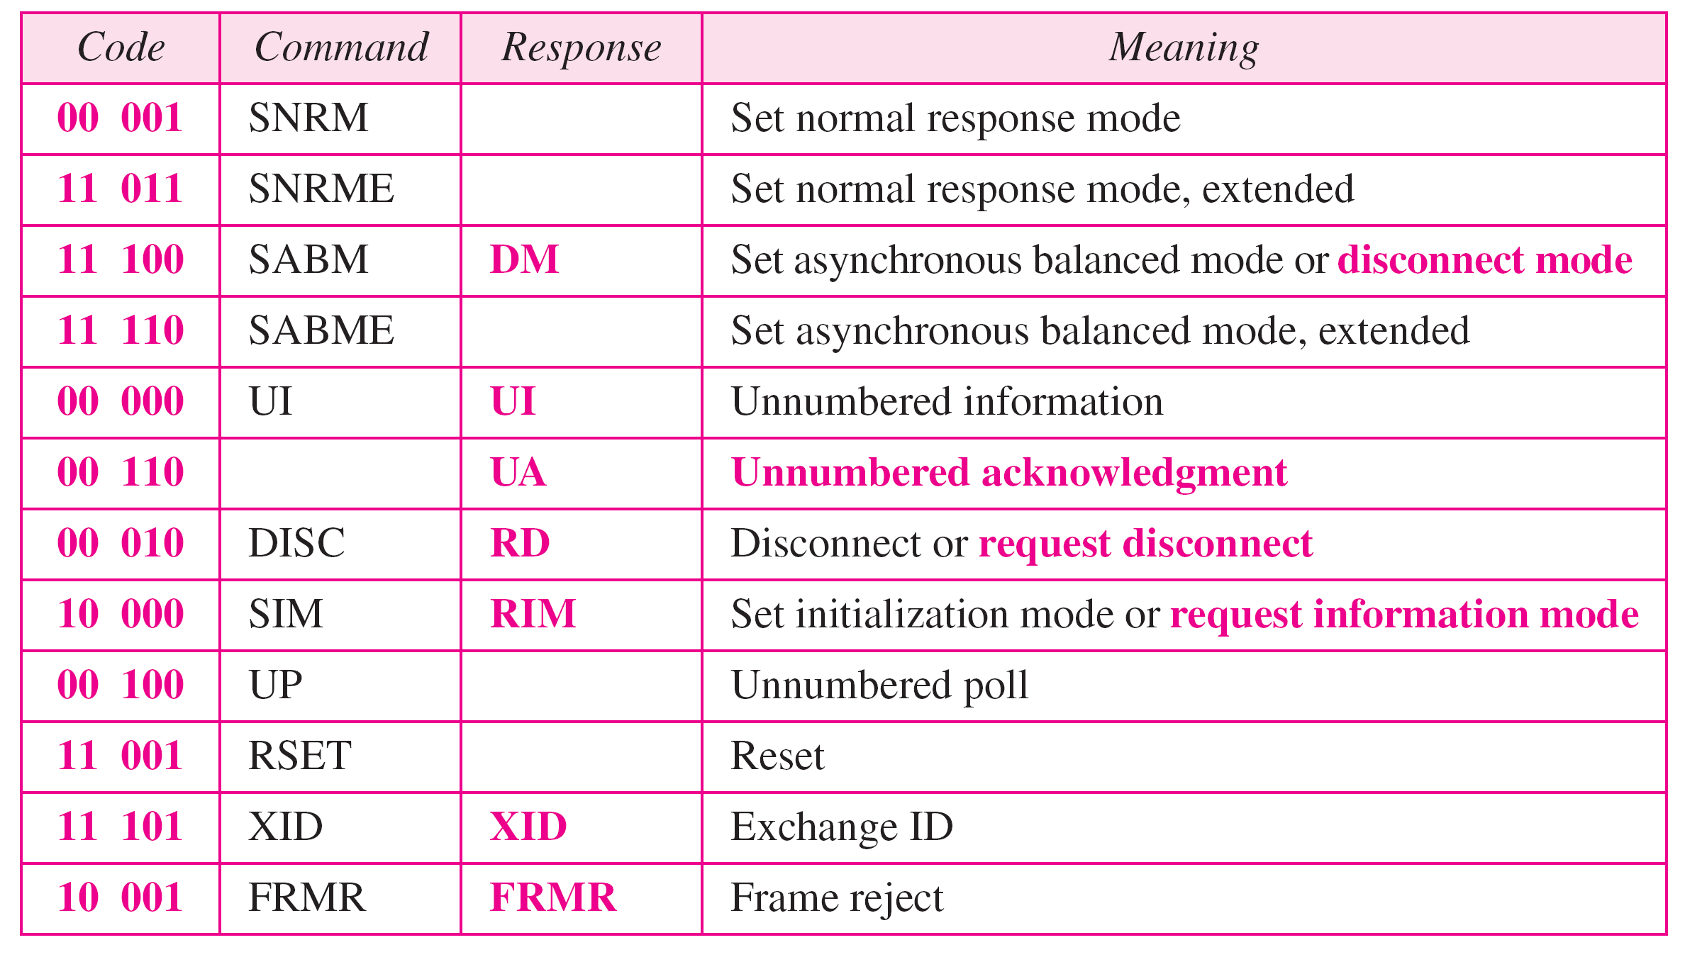
Control field for U-frame

Slide 113
Point-to-Point Protocol (PPP)

Slide 114
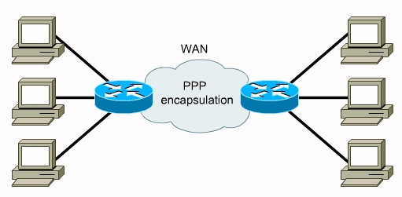
The Internet needs a point-to-point protocol for a variety of purposes, including router-to-router traffic and home user-to-ISP traffic.

Slide 115
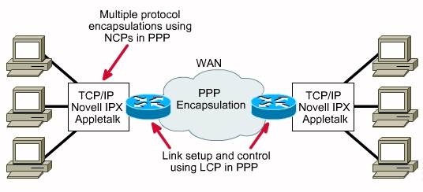
PPP Layer Function
In order to move data between any two nodes or routers, a data path must be established, and flow control procedures must be in place to ensure delivery of data.

Slide 116
PPP provides three features:
A framing method that unambiguously delineates the end of one frame and the start of the next one. The frame format also handles error detection.
A link control protocol(LCP) for bringing lines up, testing them, negotiating options, and bringing them down again gracefully when they are no longer needed.
Network Control Protocol (NCP) to negotiate network-layer options in a way that is independent of the network layer protocol to be used.

Slide 117
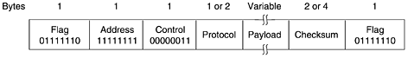
Frame Format
All PPP frames begin with the standard HDLC flag byte (01111110), which is byte stuffed if it occurs within the payload field.
The Address field, which is always set to the binary value 11111111 to indicate that all stations are to accept the frame.
The Address field is followed by the Control field, the default value of which is 00000011. This value indicates an unnumbered frame. In other words, PPP does not provide reliable transmission using sequence numbers and acknowledgements as the default

Slide 118
The fourth PPP field is the Protocol field. Its job is to tell what kind of packet is in the Payload field. Protocols starting with a 0 bit are network layer protocols such as IP, IPX, OSI CLNP, XNS. Those starting with a 1 bit are used to negotiate other protocols.
These include LCP and a different NCP for each network layer protocol supported. The default size of the Protocol field is 2 bytes, but it can be negotiated down to 1 byte using LCP.
The Payload field is variable length, up to some negotiated maximum. If the length is not negotiated using LCP during line setup, a default length of 1500 bytes is used.
After the Payload field comes the Checksum field, which is normally 2 bytes, but a 4-byte checksum can be negotiated.

Slide 119
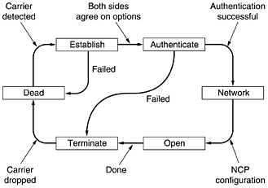
A simplified phase diagram for bringing a line up and down

Slide 120
The protocol starts with the line in the DEAD state, which means that no physical layer carrier is present and no physical layer connection exists.
After physical connection is established, the line moves to ESTABLISH.
At that point LCP option negotiation begins, which, if successful, leads to AUTHENTICATE. Now the two parties can check on each other's identities if desired.
When the NETWORK phase is entered, the appropriate NCP protocol is invoked to configure the network layer.
If the configuration is successful, OPEN is reached and data transport can take place.
When data transport is finished, the line moves into the TERMINATE phase, and from there, back to DEAD when the carrier is dropped.

Slide 121
LCP negotiates data link protocol options during the ESTABLISH phase. The LCP protocol is not actually concerned with the options themselves, but with the mechanism for negotiation. It provides a way for the initiating process to make a proposal and for the responding process to accept or reject it, in whole or in part. It also provides a way for the two processes to test the line quality to see if they consider it good enough to set up a connection. Finally, the LCP protocol also allows lines to be taken down when they are no longer needed.

Slide 122
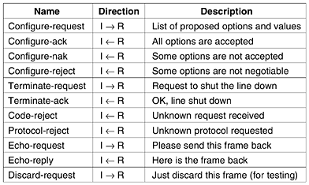
The LCP frame types.

Slide 123
The four Configure- types allow the initiator (I) to propose option values and the responder (R) to accept or reject them. In the latter case, the responder can make an alternative proposal or announce that it is not willing to negotiate certain options at all. The options being negotiated and their proposed values are part of the LCP frames.

Slide 124
The Terminate- codes shut a line down when it is no longer needed. The Code-reject and Protocol-reject codes indicate that the responder got something that it does not understand. This situation could mean that an undetected transmission error has occurred, but more likely it means that the initiator and responder are running different versions of the LCP protocol. The Echo- types are used to test the line quality. Finally, Discard-request help debugging. If either end is having trouble getting bits onto the wire, the programmer can use this type for testing. If it manages to get through, the receiver just throws it away, rather than taking some other action that might confuse the person doing the testing.

Slide 125
The options that can be negotiated include setting the maximum payload size for data frames, enabling authentication and choosing a protocol to use, enabling line-quality monitoring during normal operation, and selecting various header compression options. There is little to say about the NCP protocols in a general way. Each one is specific to some network layer protocol and allows configuration requests to be made that are specific to that protocol. For IP, for example, dynamic address assignment is the most important possibility.

